Slide 1
Week 3
Group 5

Slide 2
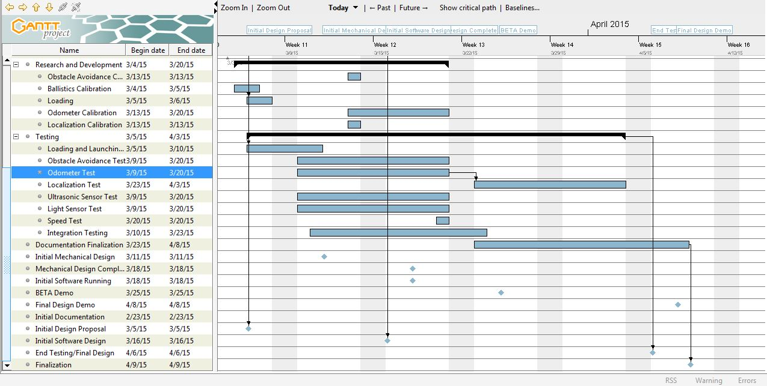
Gantt Chart Update

Slide 3
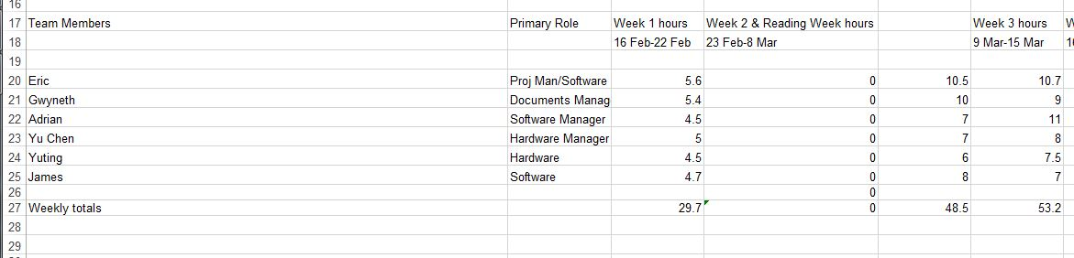
Budget

Slide 4
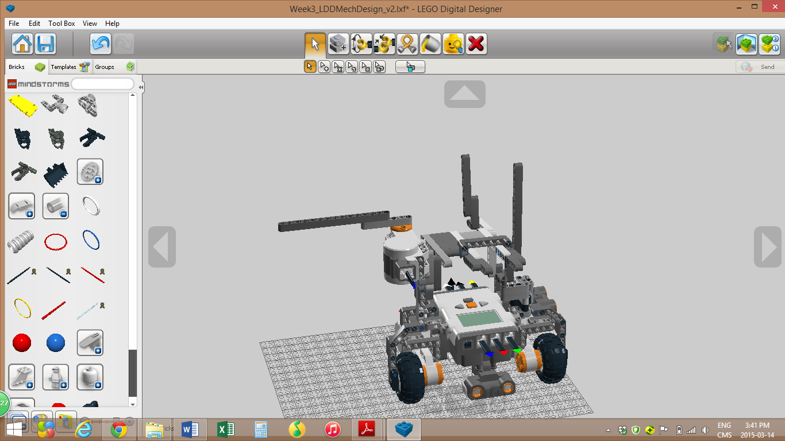
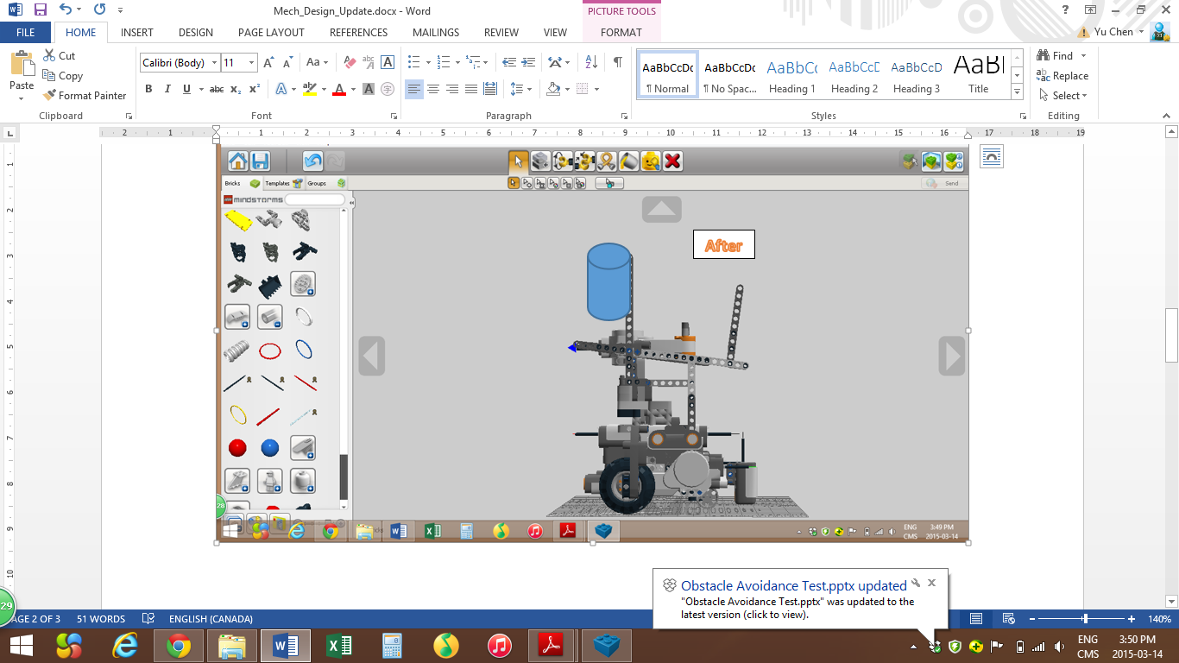
Mechanic update
Loading
Before

Slide 5
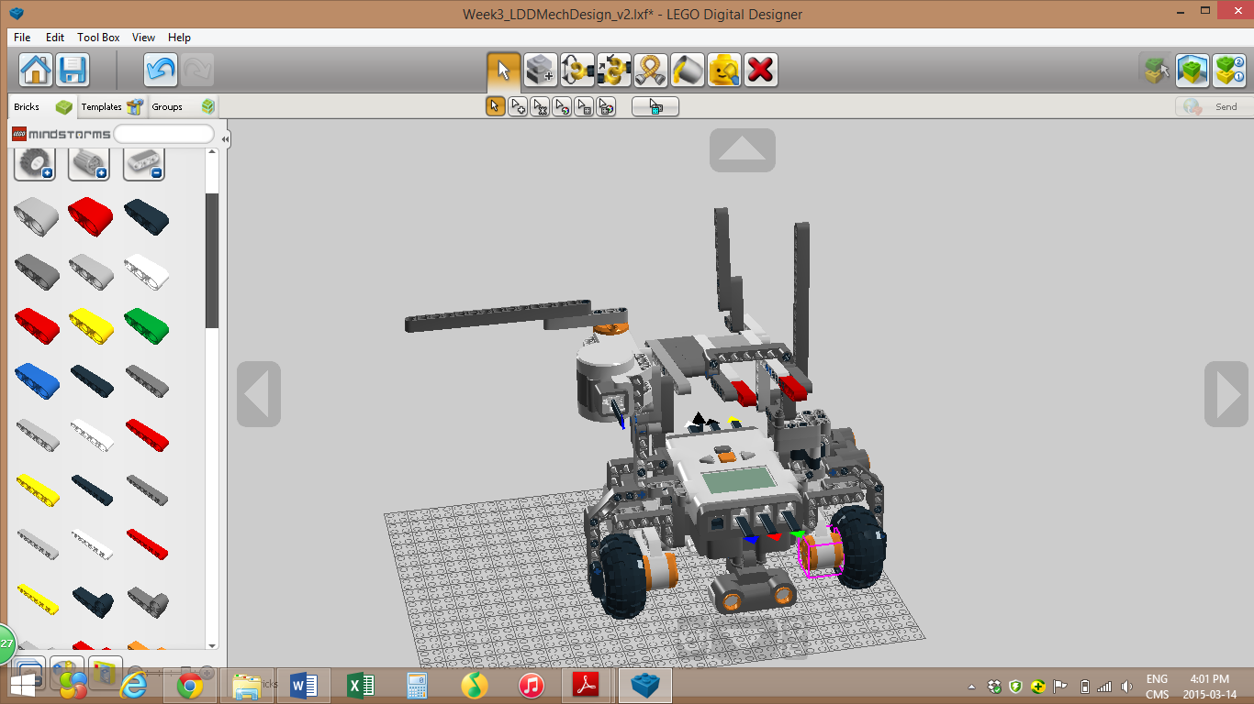
Mechanic update
Ball resting zone

Slide 6
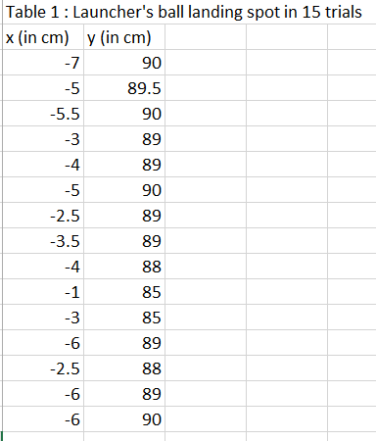
Launcher test

Slide 7
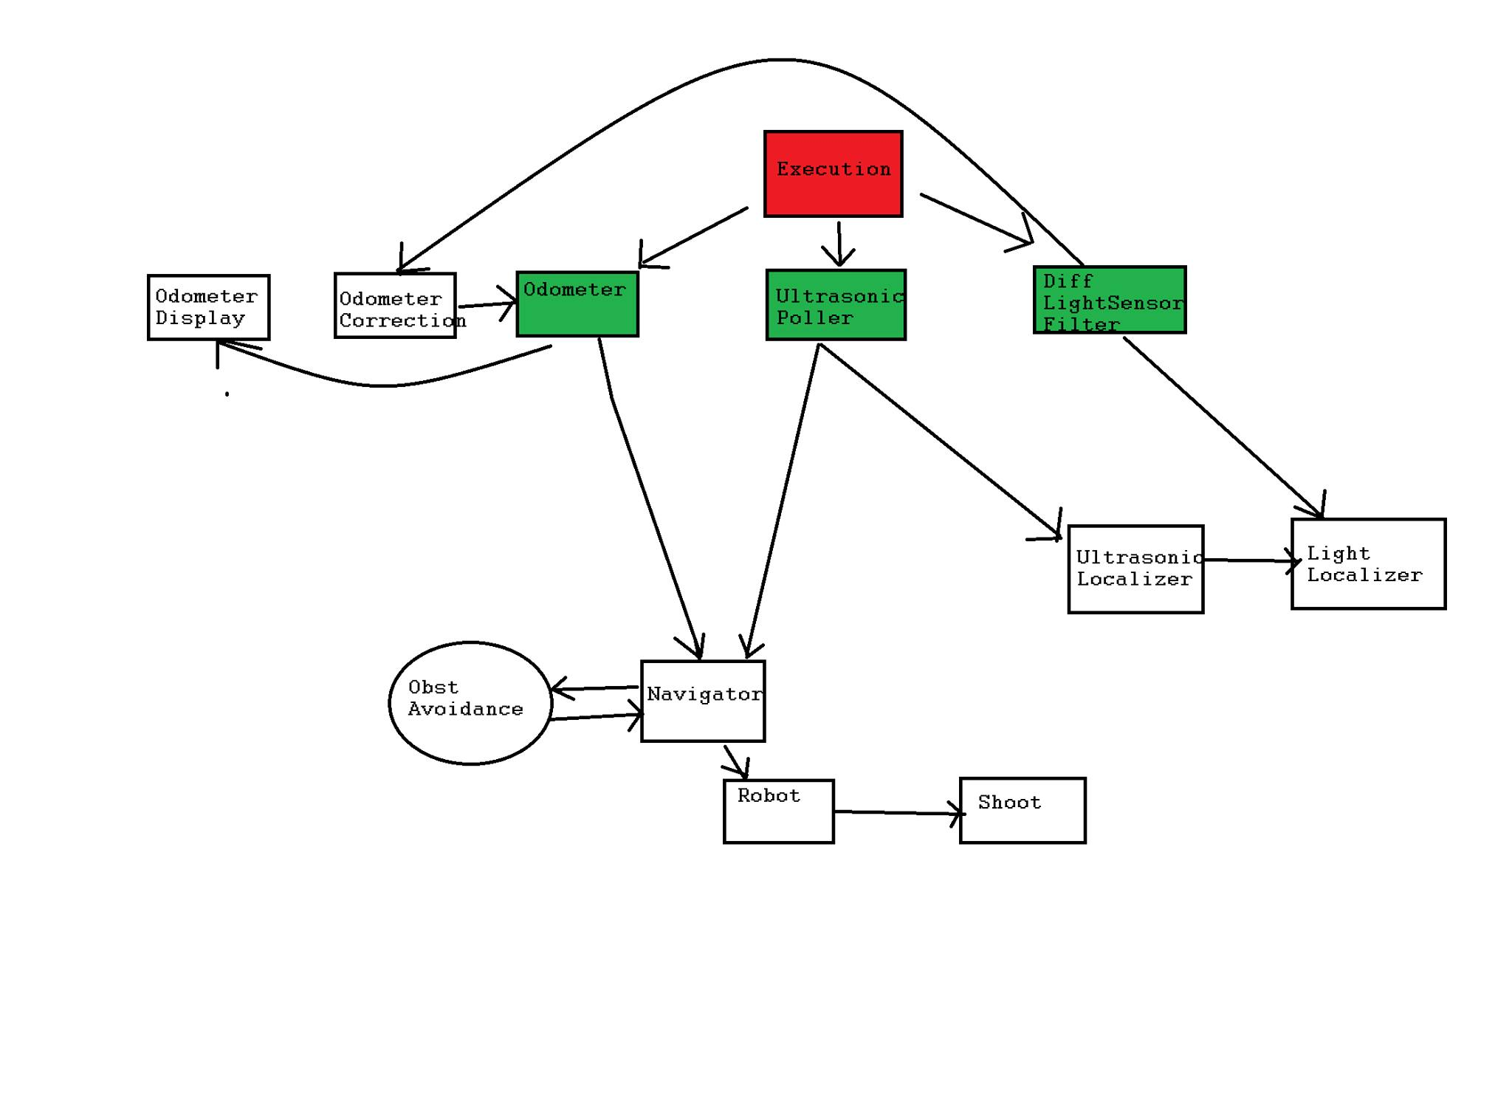
Software Architecture

Slide 8
Localization Test (Orientation)
PROCEDURE
1.Place the robot at arbitrary positions in the start area
2. Start the robot’s rising-edge method
3. After the robot determines its orientation, record the measured degree and actual degree using a protractor
4. Repeat step 1 and 3 ten times.
5. Repeat step 1 and 3 ten times with falling edge method

Slide 9
Test Results
Table 1 : Localization accuracy of the rising edge method using ultrasonic sensor
trial # | Calculated orientation (in degree) | Actual orientation (in degree) | Error (in degree)
1 | -1 | 4 | 5
2 | -1 | -1 | 0
3 | 0 | 6 | 6
4 | -1 | 7 | 8
5 | 0 | 3 | 3
6 | 0 | 0 | 0
7 | -1 | 5 | 6
8 | 0 | 6 | 6
9 | -1 | 0 | 1
10 | 0 | 6 | 6
Table 2 : Localization accuracy of the falling edge method using ultrasonic sensor
trial # | Calculated orientation (in degree) | Actual orientation (in degree) | Error (in degree)
1 | -1 | -6 | -5
2 | -1 | -3 | -2
3 | -1 | -3 | -2
4 | -1 | -6 | -5
5 | -1 | -4 | -3
6 | -1 | -2 | -1
7 | -1 | -3 | -2
8 | -1 | -8 | -7
9 | -1 | -2 | -1
10 | -1 | -1 | 0

Slide 10
Test Report
The collected results are very positive, as the both rising and falling edge methods can be considered precise, as shown by the standard deviation values, 2.885 and 2.201 respectively
Another test will be conducted on X,Y coordinate to determine which method to use

Slide 11
Actions
Conclusion: decline rising edge method for now
Action: Implement the falling edge method and conduct another test to determine the better of the two methods
Follow up -> Adrian Pan
Localization V1.1

Slide 12
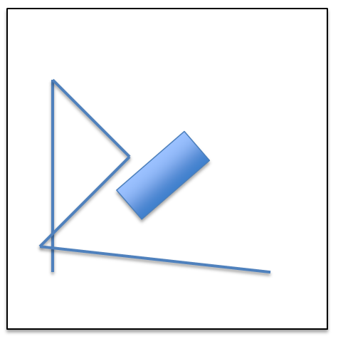
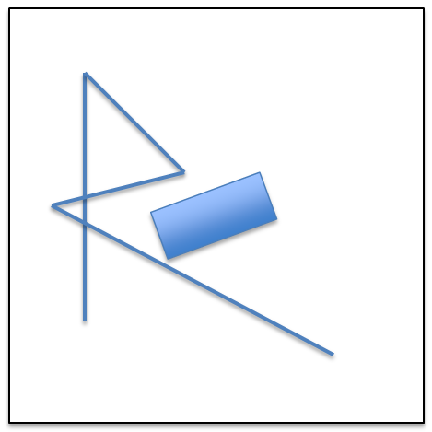
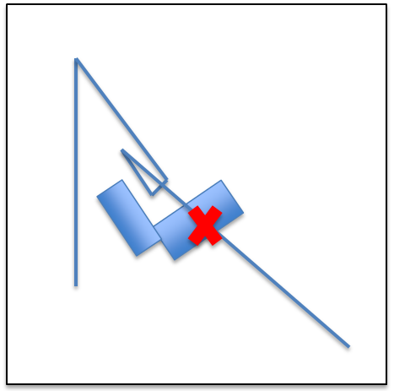
Obstacle Avoidance Test 1.0
Normal Case
Extreme Case 1
Extreme Case 2

Slide 13
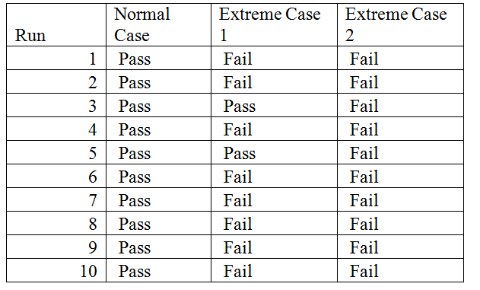
Test report
Results:
Succeed in identifying obstacle multiple times
Succeeded in navigating to waypoint (correct orientation)
Passed Normal Case
Failed Extreme Case 1
Failed Extreme Case 2
Table 1. Obstacle avoidance run.

Slide 14
Actions
Conclusion: Decline Obstacle_avoidance_V1.0
Action: Implement wall follower
Follow up→ Eric Vuong
Obstacle_avoidance_V1.2

Slide 15
Odometer
Testing
Problems

Slide 16
New Testing Plan
Loading and Launching
Obstacle Avoidance
Odometer
Localization
Integration
Ultrasonic Sensor Performance
Light Sensor Performance
Speed Test (optional)

Slide 17
For next week…
Odometer Correction v2
Testing
Localization v2
Testing
Documentation
Obstacle Avoidance/Navigation v2
Testing

